Slide 1
WELCOME
TO
SPAIN

Slide 2
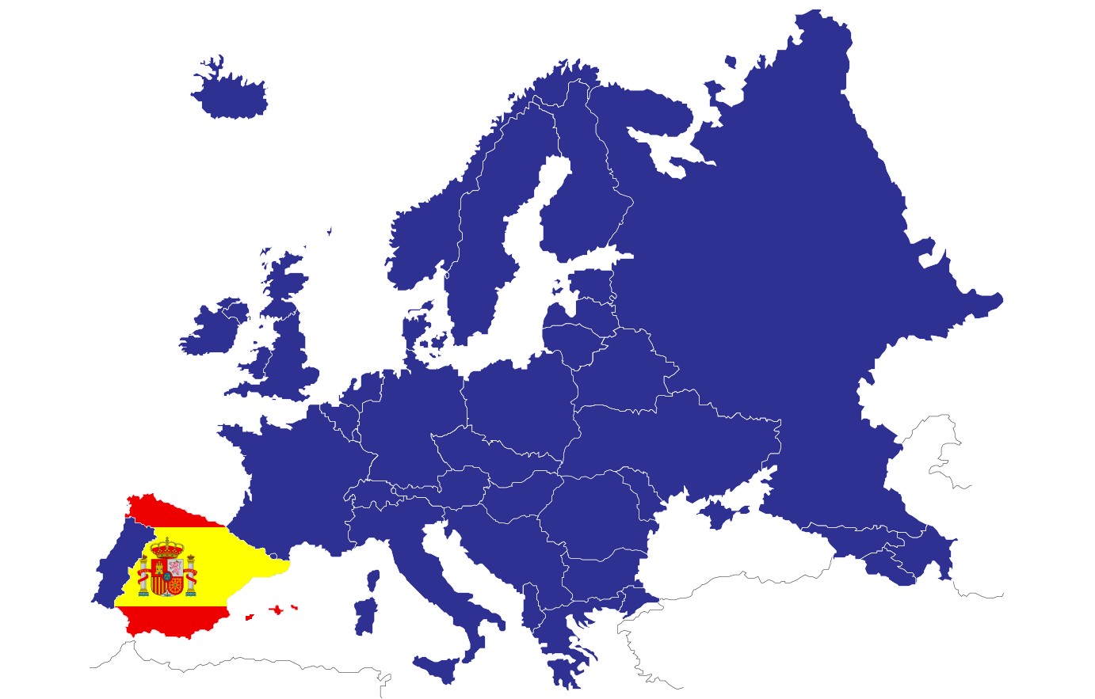
ROMANIA
PORTUGAL
ITALY
GREECE
CYPRUS
Spain is a country located in the southwest of Europe, in the so-called Iberian Peninsula, a territory that we share with Portugal.
Our climate is Mediterranean to the east and Atlantic to the northwest.

Slide 3
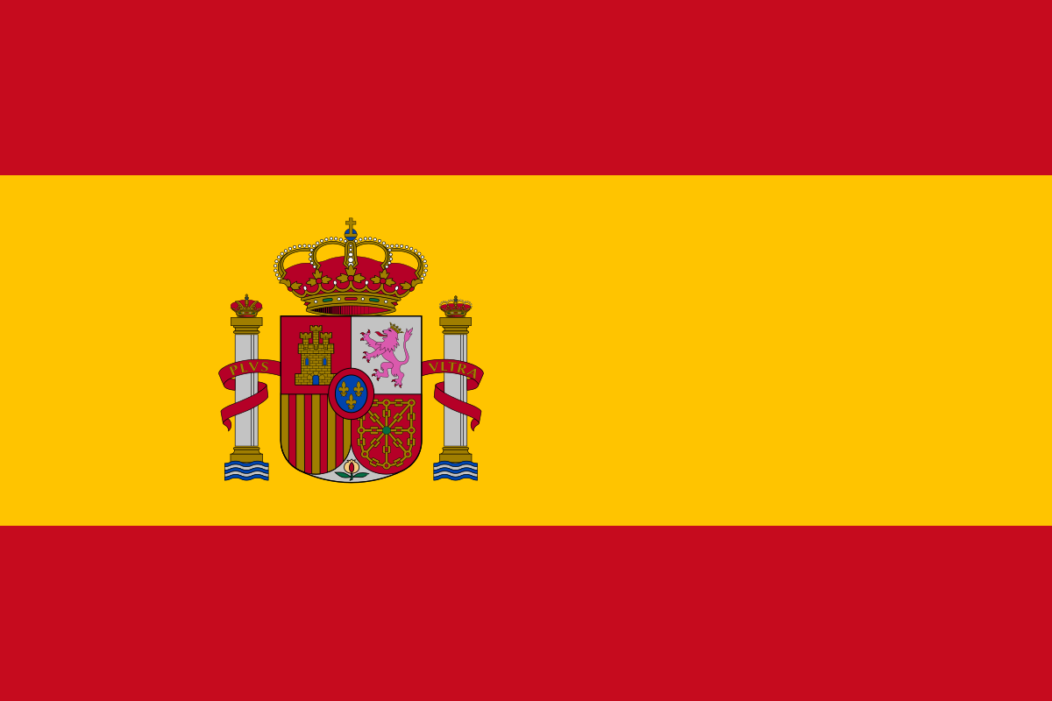
This is our flag. The colors of the Spanish flag are: red, yellow, red.
On the yellow strip (which is twice as wide as each of the red strips) you can place the country's coat of arms.

Slide 4
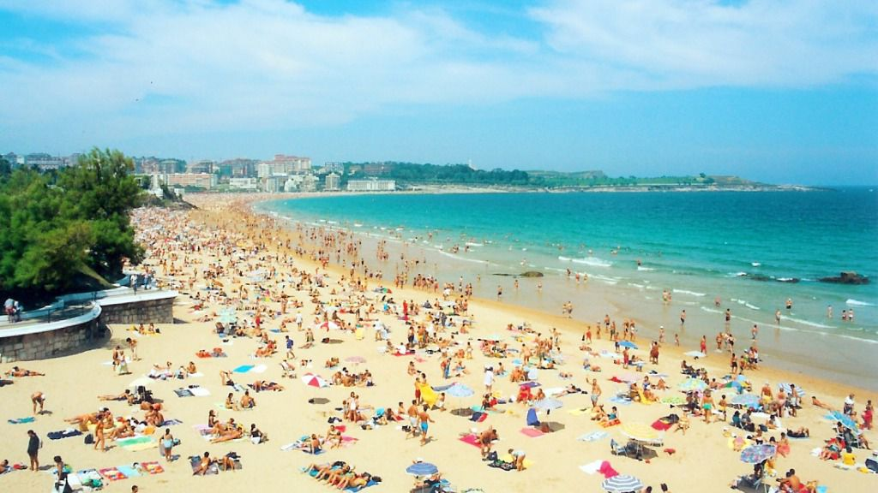
Our main economic activity is sun and beach tourism.
This is mainly due to: the natural conditions, with hot summers and excellent beaches; the close and outgoing character of Spanish people; the cultural, artistic, folkloric and gastronomic wealth; the wide supply of infrastructures…

Slide 5
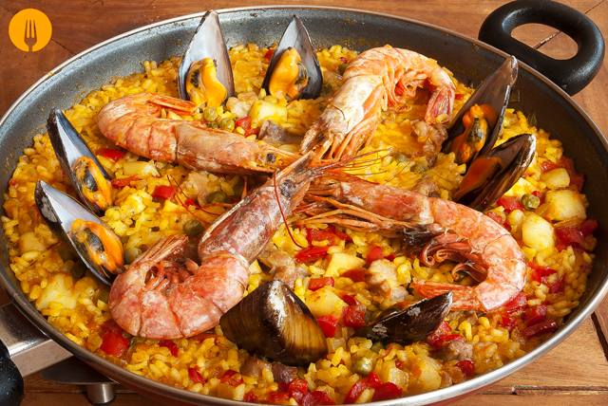
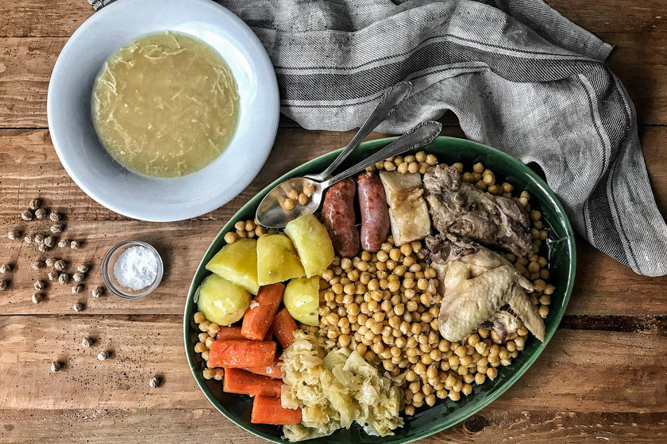
SOME TRADITIONALS FOODS
COCIDO
Typical dish that consists of cooking chickpeas, potatoes, carrots and cabbage, with bones, chicken, blood sausage, chorizo ​​...
A soup is also made with the broth.
PAELLA
Typical dish (mainly from eastern Spain) that is based on rice with prawns, broad beans, mussels, squid ...

Slide 6
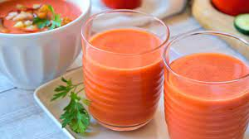
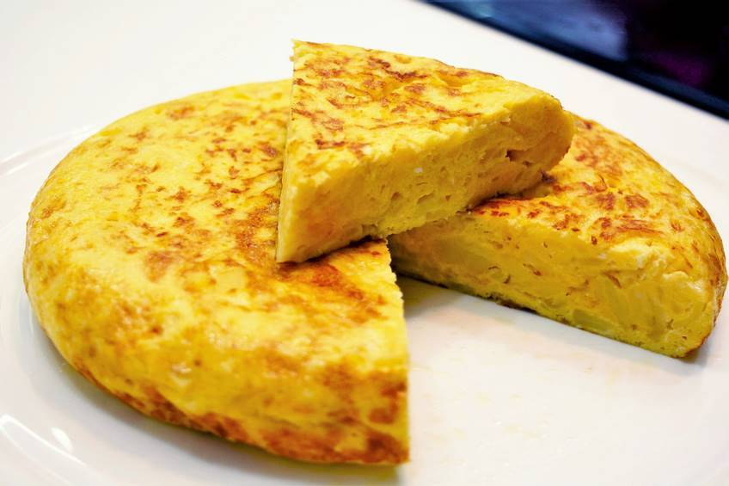
SOME TRADITIONALS FOODS
TORTILLA DE PATATAS
Typical dish that consists of a fried potato omelet with egg and sometimes onion.
GAZPACHO
Typical dish (mainly from southern Spain) consisting of a tomato, pepper, oil, garlic and salt smoothie, with a little bread. It can be taken accompanied by cucumber, onion, egg or chopped Serrano ham on top.

Slide 7
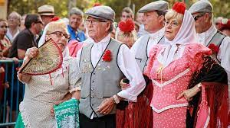
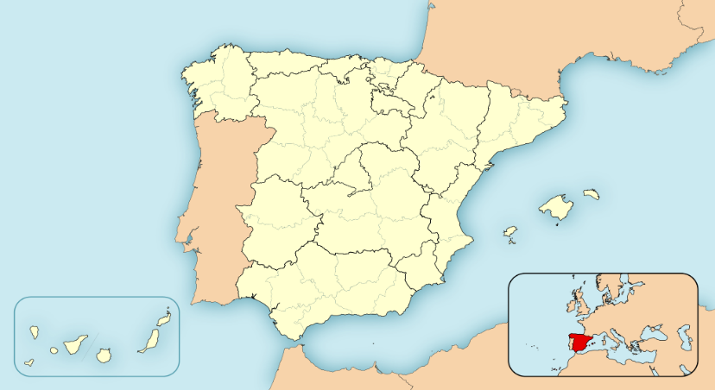
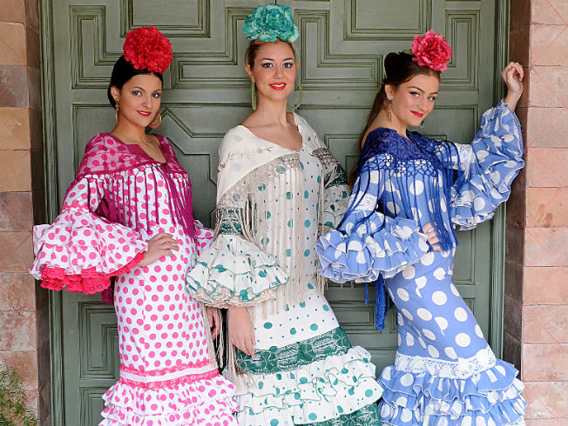
SOME TRADITIONALS CLOTHES
Andalucía
CHULAPO
Typical clothes from Madrid.
FLAMENCO
Typical clothes from Andalucía.
Madrid

Slide 8
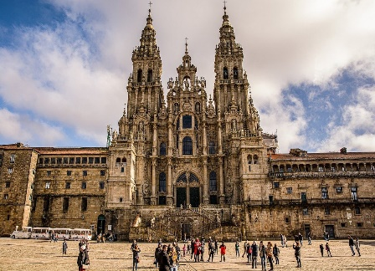
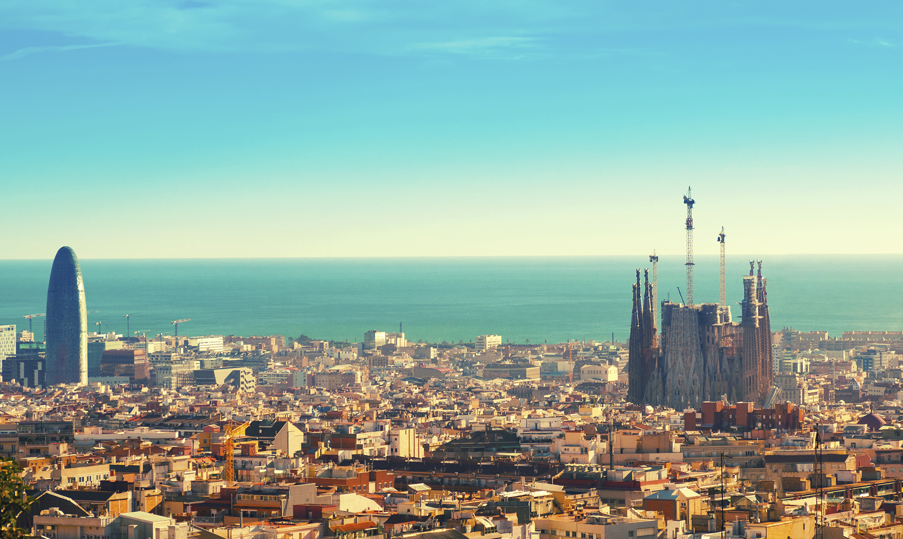
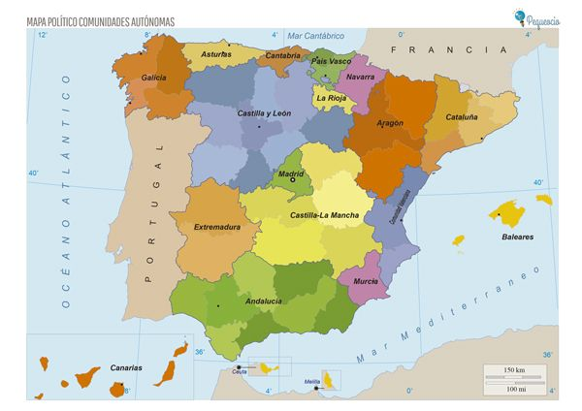
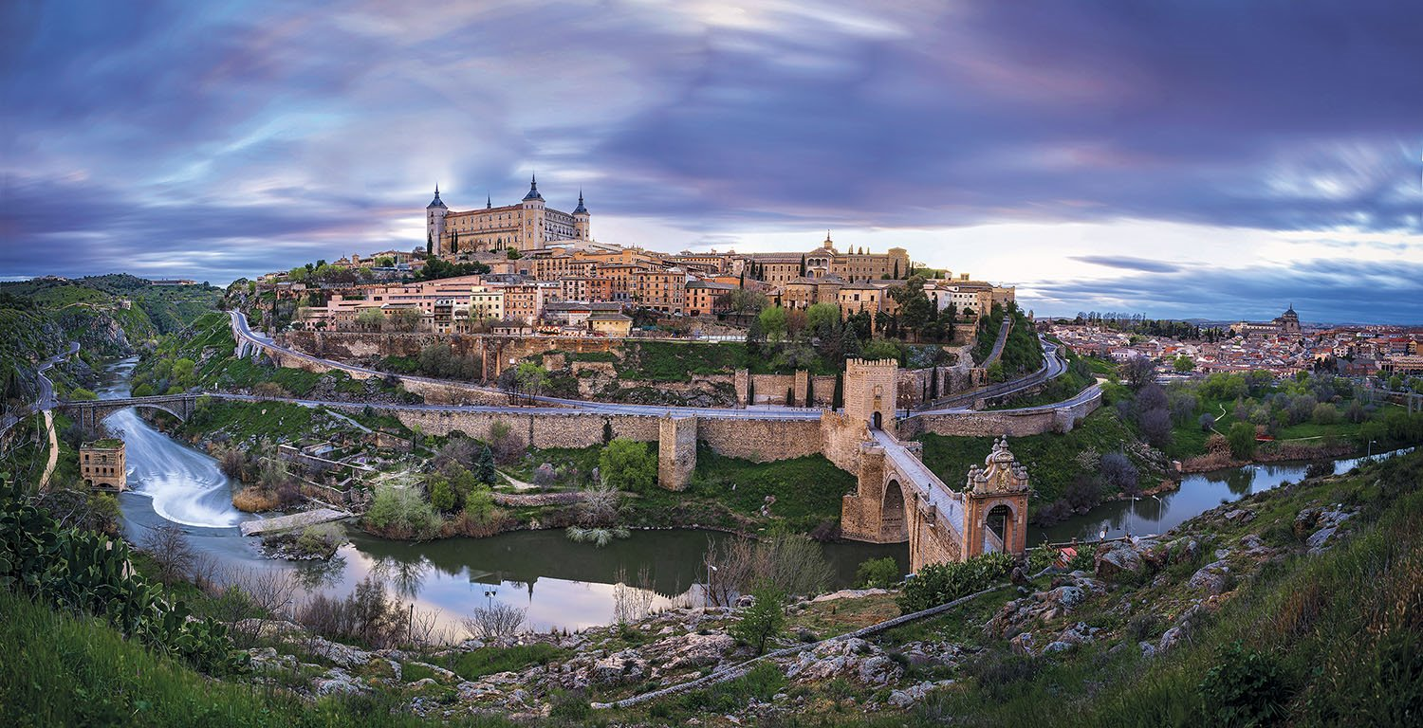
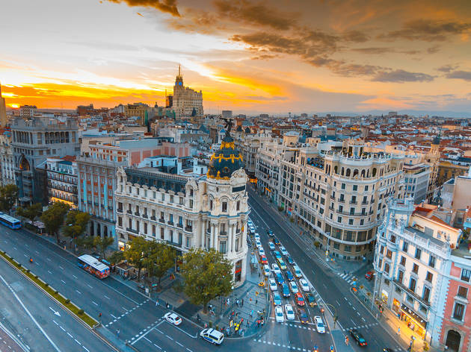
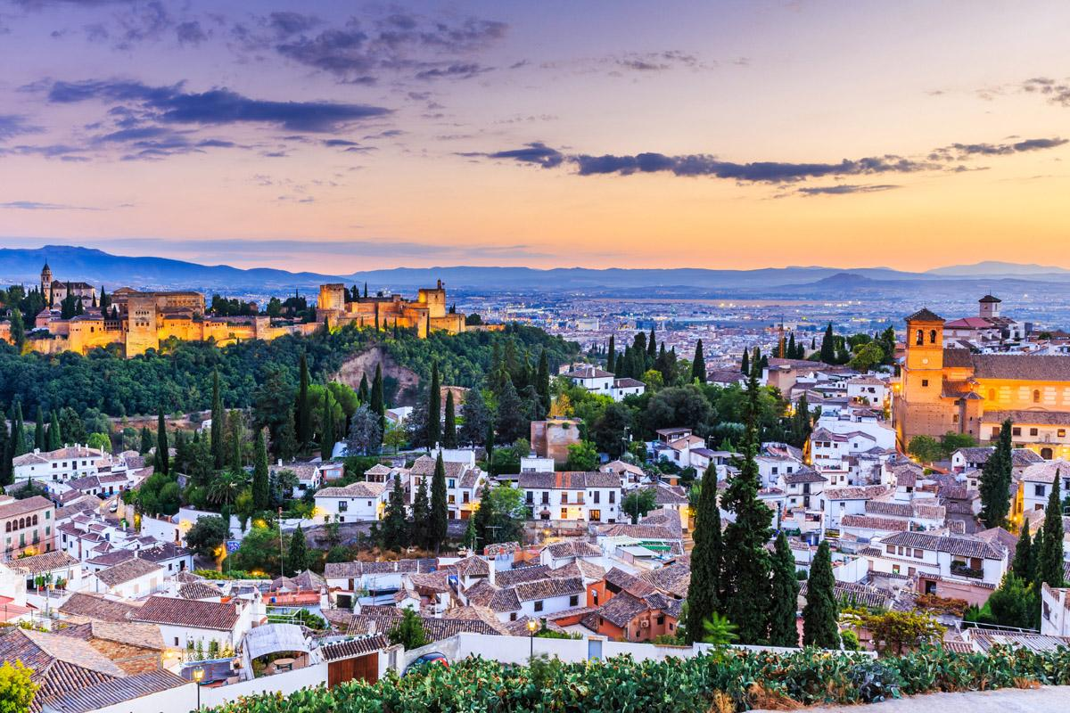
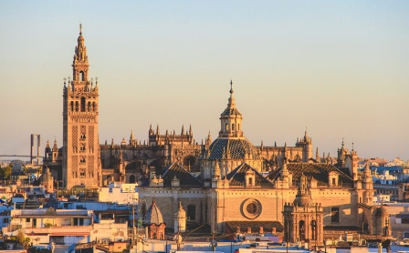
SOME IMPORTANT CITIES
SANTIAGO DE COMPOSTELA
BARCELONA
TOLEDO
MADRID
SEVILLA
GRANADA

Slide 9
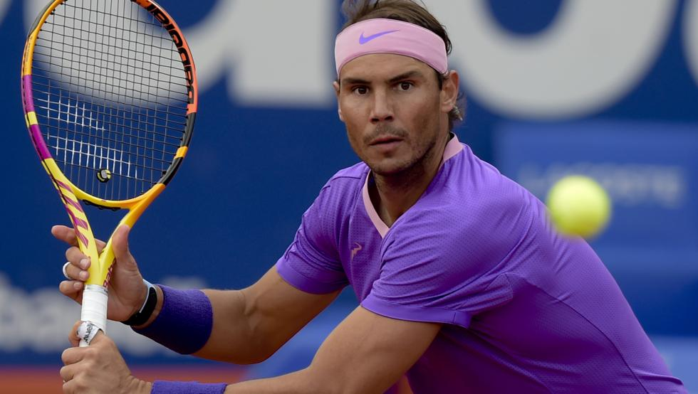
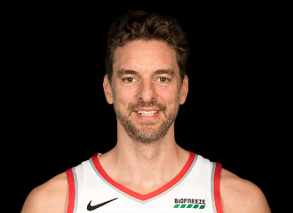
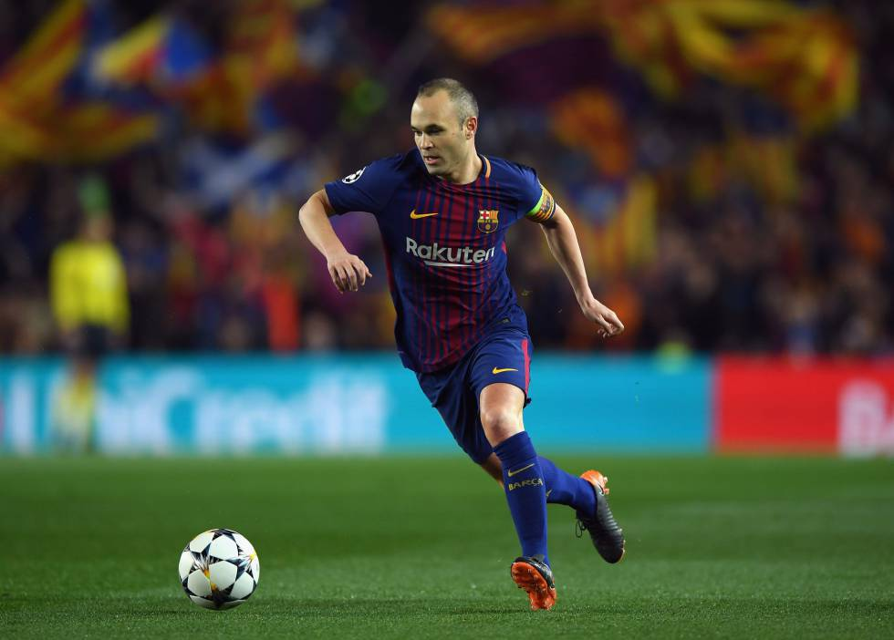
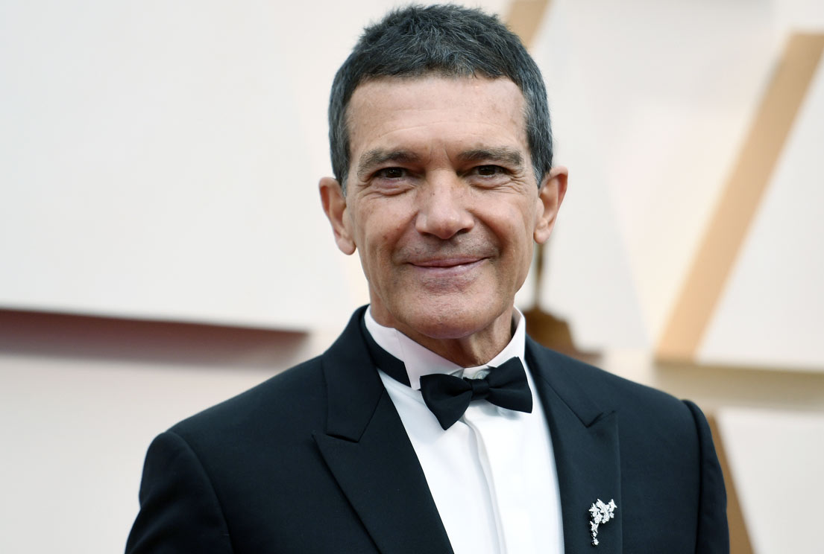
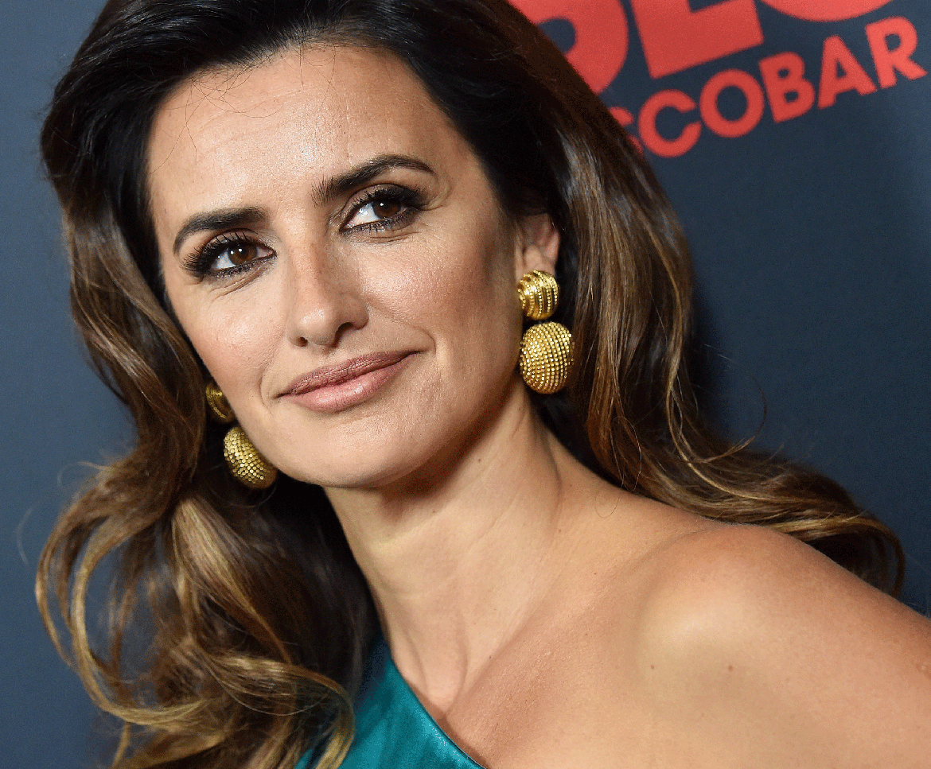
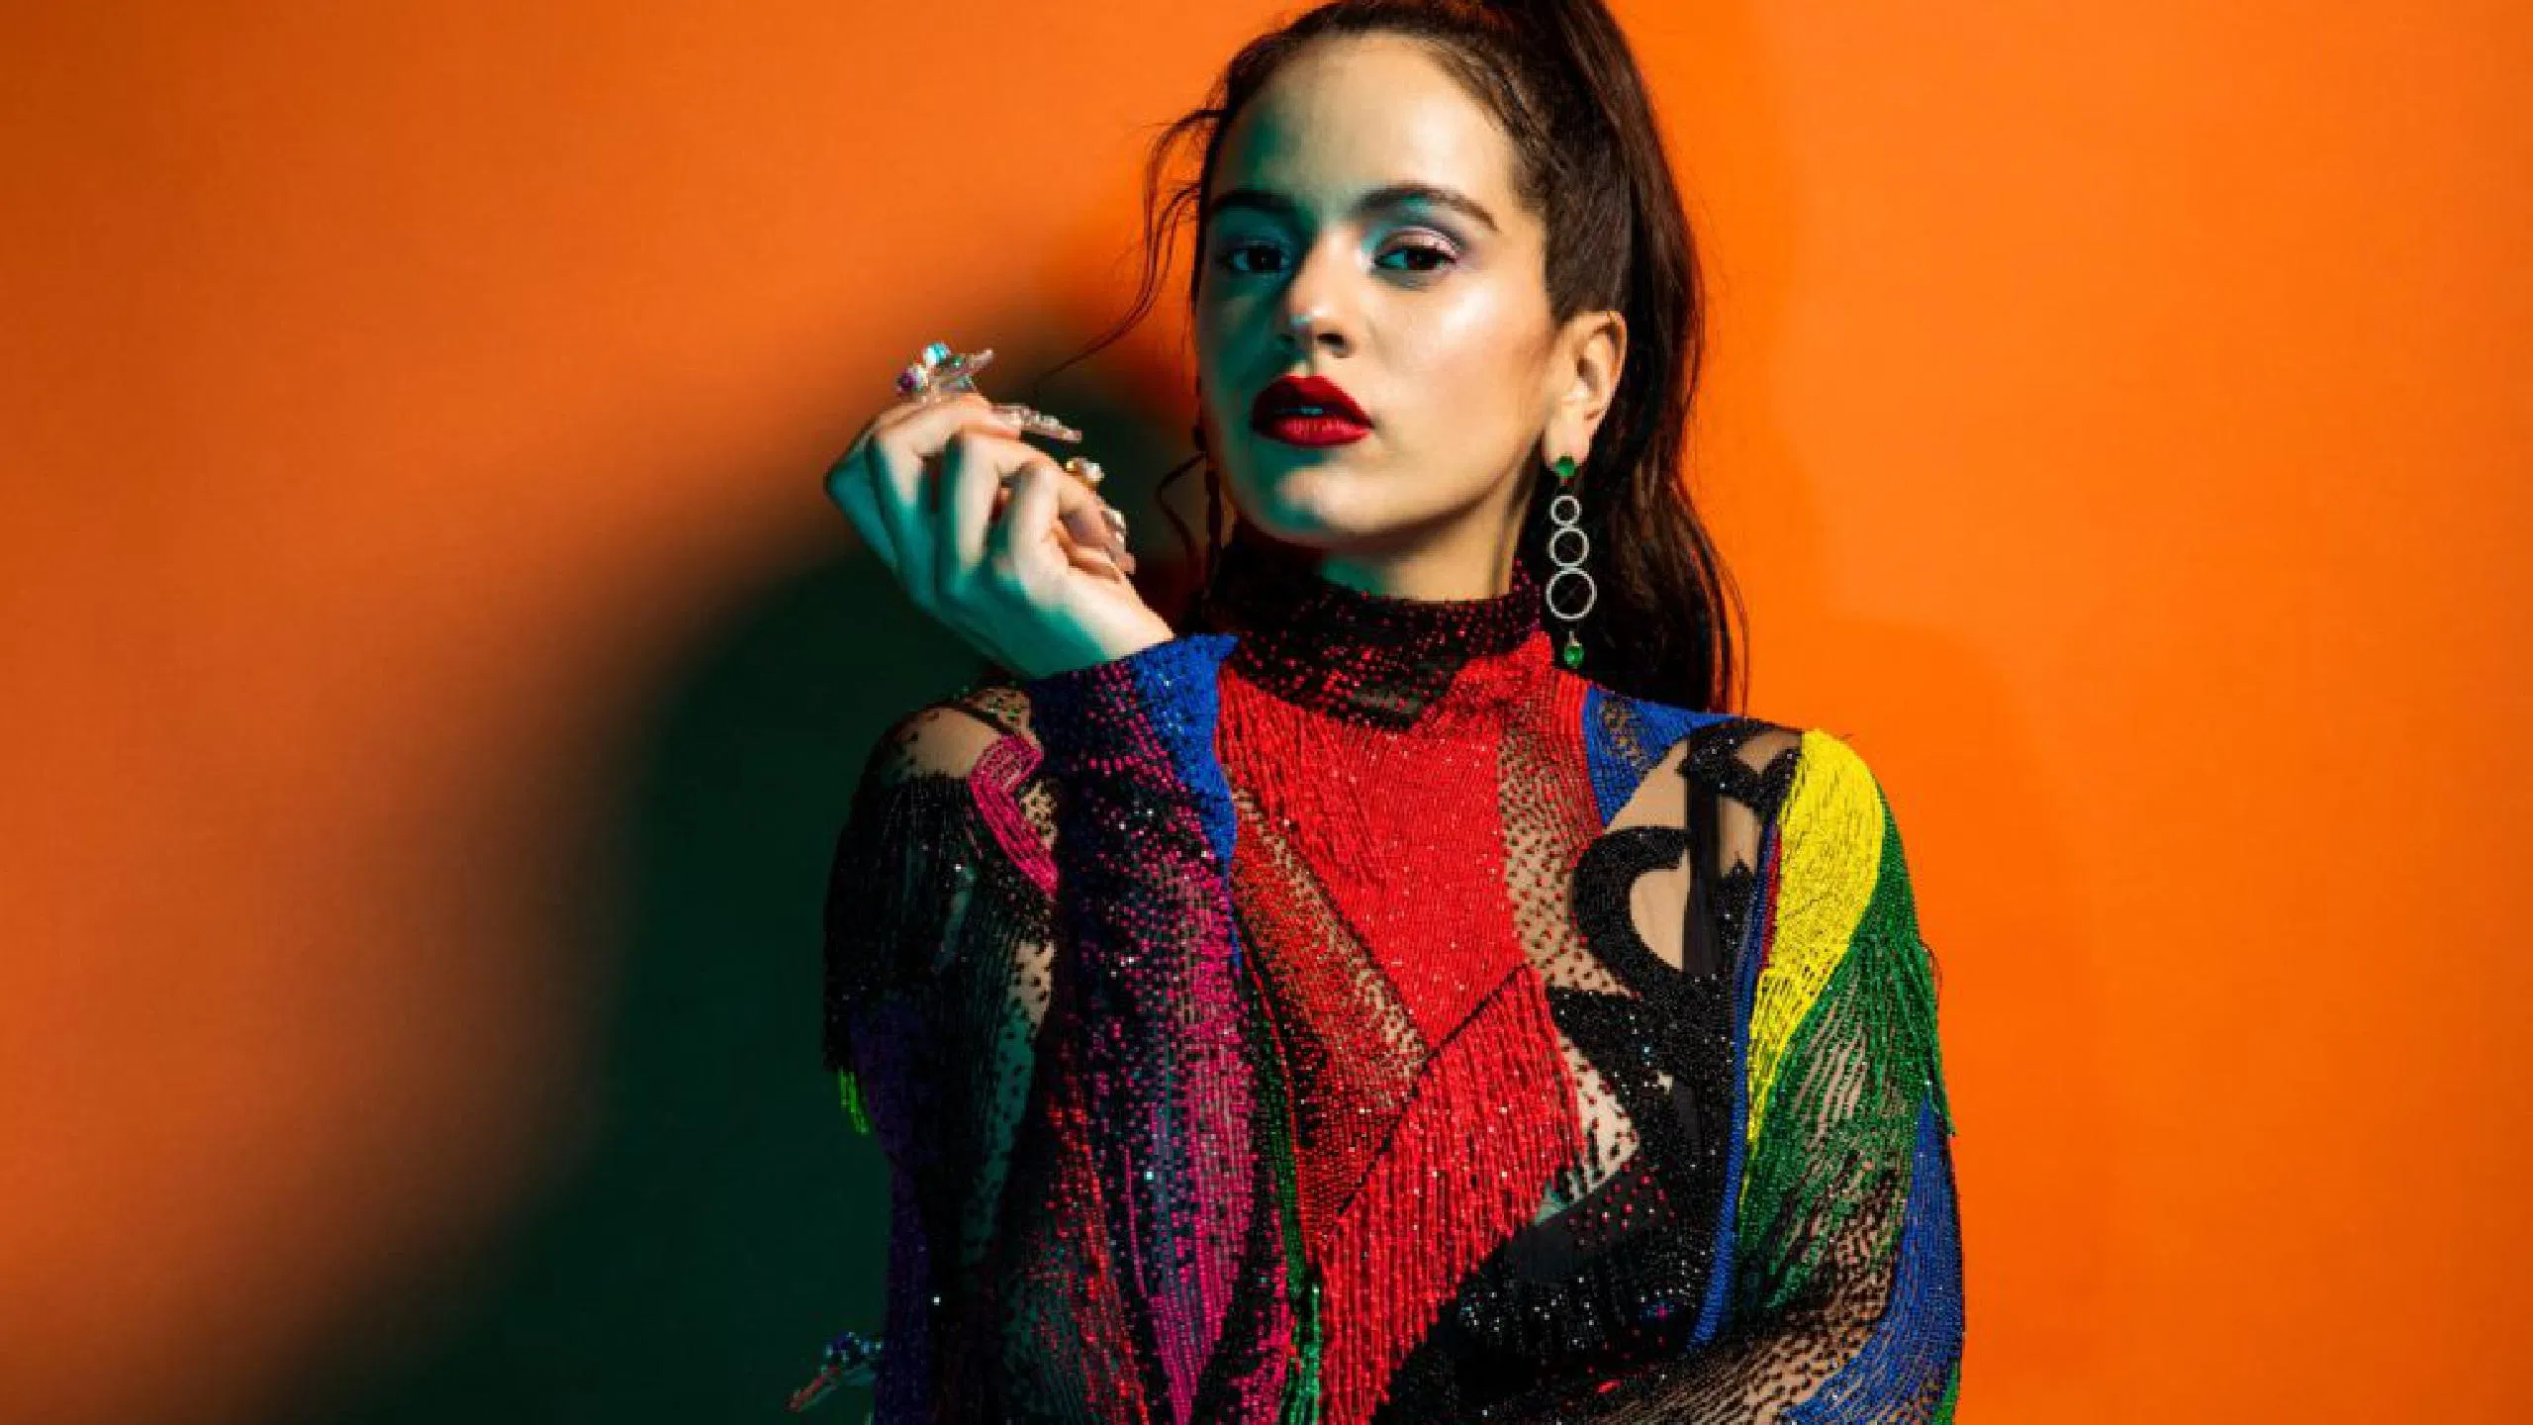
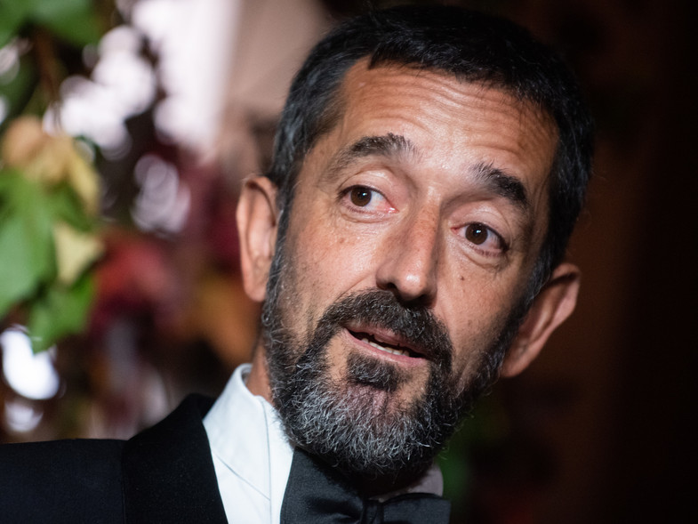
SOME FAMOUS PEOPLE
RAFA NADAL
(tennis player)
PAU GASOL
(basketbal player)
MIREIA BELMONTE
(swimmer)
ANDRÉS INIESTA
(football player)
ANTONIO BANDERAS
(actor)
PENELOPE CRUZ
(actress)
ROSALÍA
(singer)
PEDRO CAVADAS
(doctor)

Slide 10
